Slide 1


EENG385 - Electronic Devices and Circuits
Lecture 02:
Schmitt Trigger Relaxation Oscillator
Objective:
The objective of this lab is to introduce you to the use of positive feedback in the construction of an oscillator.

Slide 2
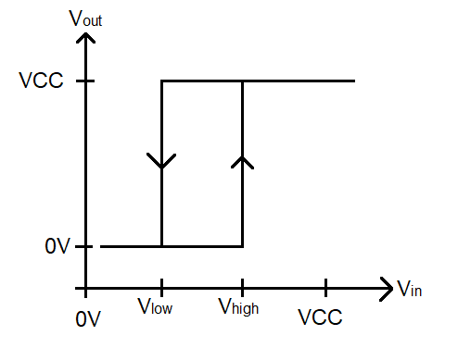
Schmitt Trigger
Schmitt Trigger has memory
  If (V_{in} > V_{high}) then V_{out} = V_{CC}
  If (V_{in} < V_{low}) then V_{out} = 0V
  If (V_{low} < Vin < V_{high}) then V_{out} remains unchanged

Slide 3
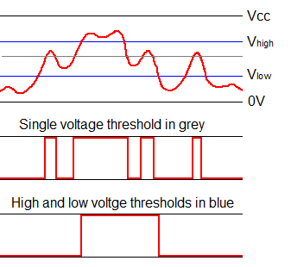
Schmitt Trigger
Good for noise rejection
Analog signal (top) converted with a single threshold (middle) then Schmitt trigger (bottom).

Slide 4
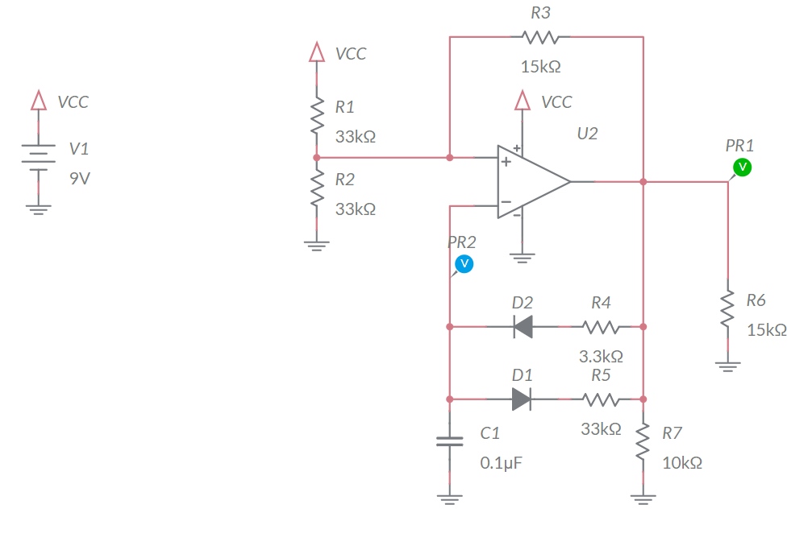
Analyze
VCC = 9V
Assume Vout = 9V
  C1 charges through R4
  V- increase through
  Causing Vout = 0V
Assume Vout = 0V
  C1 discharges through R5
  V- decreases
  Causing Vout = 9V

Slide 5
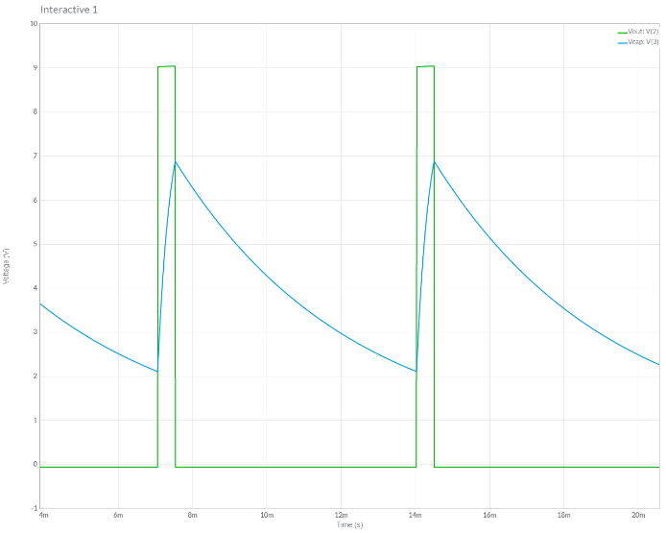
Simulate
Use MultiSim Live
Set initial conditions on capacitor
Probe op amp output and capacitor voltage

Slide 6
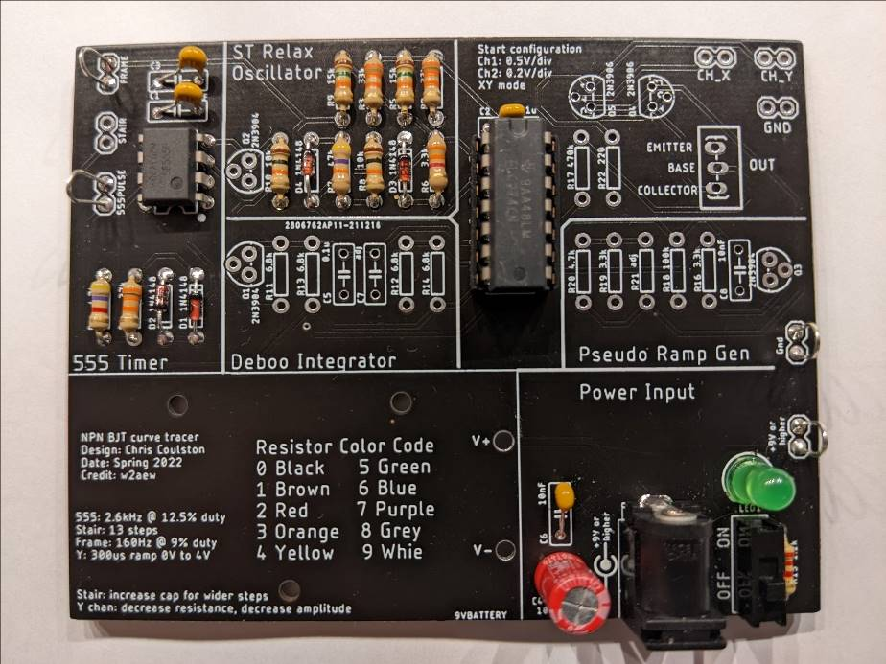
Assemble
Capacitor is adjacent to TLC274
Use 14-pin socket for TLC274

Slide 7
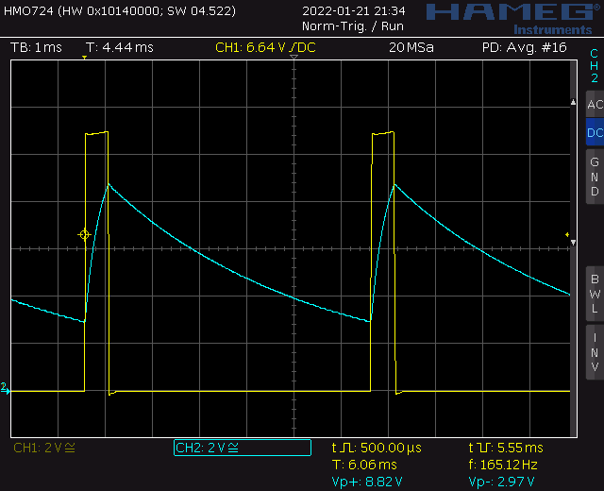
Test
Probe op amp output and capacitor voltage
Should be close (within 25%) to simulation

Slide 8
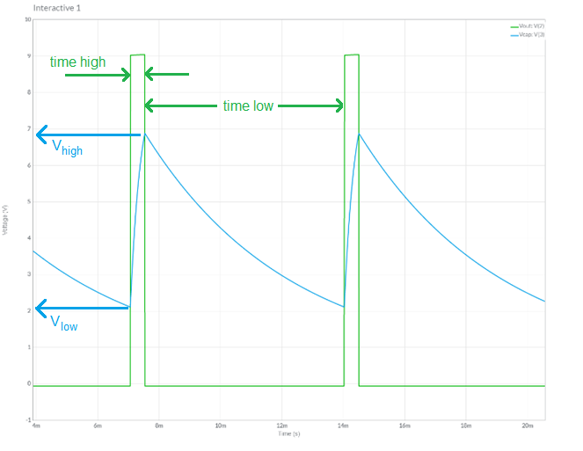
Turn in
Summary of analysis, simulation and assemble
  Table 4 op amp output
  Table 5 capacitor C1

